Slide 1
Ostermalm vs Sodermalm
A battle for the best location for a new coffee shop
in Stockholm

Slide 2
Goal
The goal of this project is to determine which would be the best location for opening up a new coffee shop, between Ostermalm and Sodermalm, which are two central districts in Stockholm.

Slide 3
Background
Sweden is one of the top coffee drinking countries in the world. Stockholm is the capital of Sweden, and the most populous city. A company looking to expand its operations with a target of growing in Sweden, and in Scandinavia more generally (Scandinavian countries are all heavy coffee drinkers), will want to start in Stockholm.
Stockholm presents an ideal foothold in Sweden and Scandinavia more broadly for a coffee shop, as it is a large population center and a likely starting point for diffusion across the region. There are likely already incumbents, however, and so there is a threat of competition.
Ideal target locations would blend a combination of opportunity with this competitive threat.
The analysis will require balancing the costs and benefits of the various regions within Stockholm. Negative criteria should include competitive threats, including the number of pre-existing coffee shops, while positive criteria should include population and proximity to other venues.

Slide 4
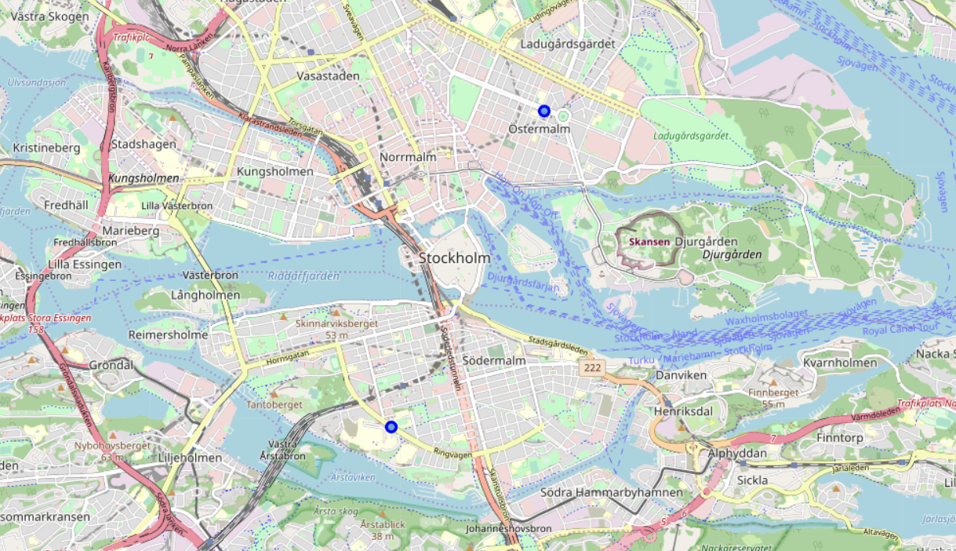
Locations
Ostermalm and Sodermalm are two central districts in Stockholm

Slide 5
Interested Parties
This project would be interesting to those wishing to get a foothold in the coffee market in Northern Europe. Specifically, this would help clarify what the best location would be for opening a coffee shop in Stockholm, with the aim that this first coffee shop would be the initial break-in for further expansion in the area.
More generally, this type of analysis could be broadened for further products and regions, including for new gyms, restaurants, etc.

Slide 6
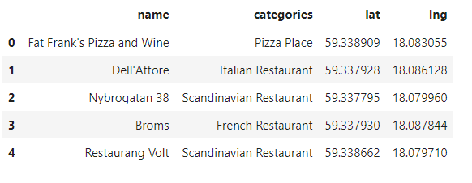
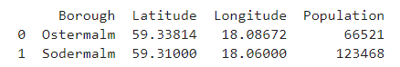
Data
The data needed for this project includes location data within Stockholm as well as venue data from Foursquare.

Slide 7
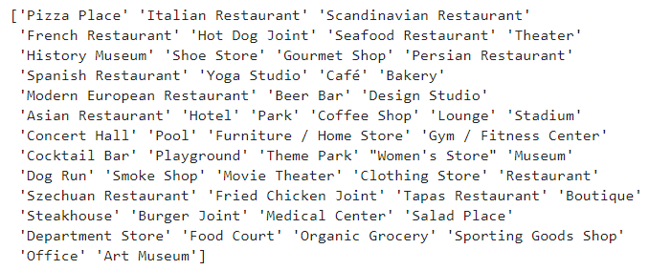
Methodology
The base of the project relies on pulling venue data centered around Ostermalm and Sodermalm in Sweden
The crux of the issue is determining how to categorize the competition and attractions that serve as negative and positive influences on the decision to choose between the two neighborhoods.
In each of the neighborhoods, a choice needs to be made of which venues to group into the two categories

Slide 8
Methodology (continued)
For competitive threats, cafes, coffee shops and bistros are included
For attractions, bookstore, movie theaters, gyms, plazas, dance studios, food courts, theaters, boutiques, antique shops, opera houses, history museums, shoe stores, yoga studios, hotels, parks, stadiums, concert halls, furniture stores, theme parks, women’s stores, museums, boutiques, department stores, art museums, and offices

Slide 9
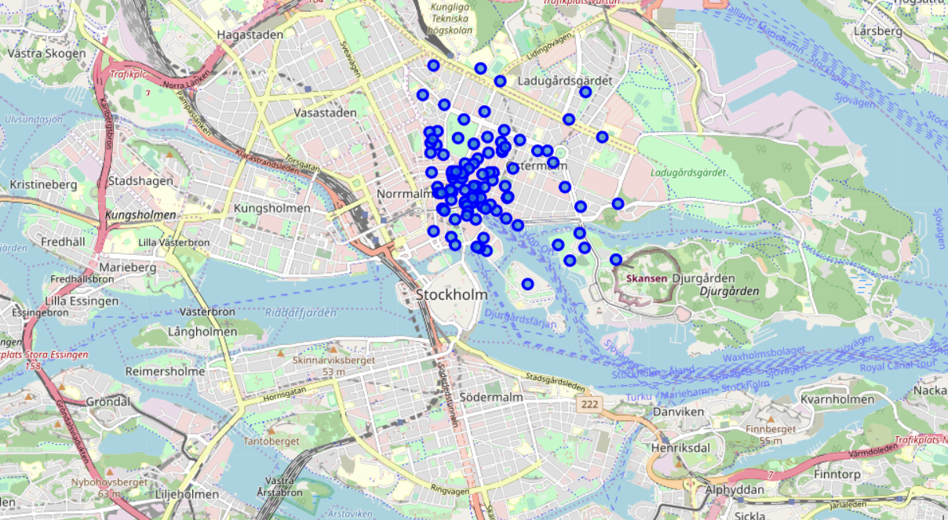
Results
The following map shows the location of the venues in Ostermalm

Slide 10
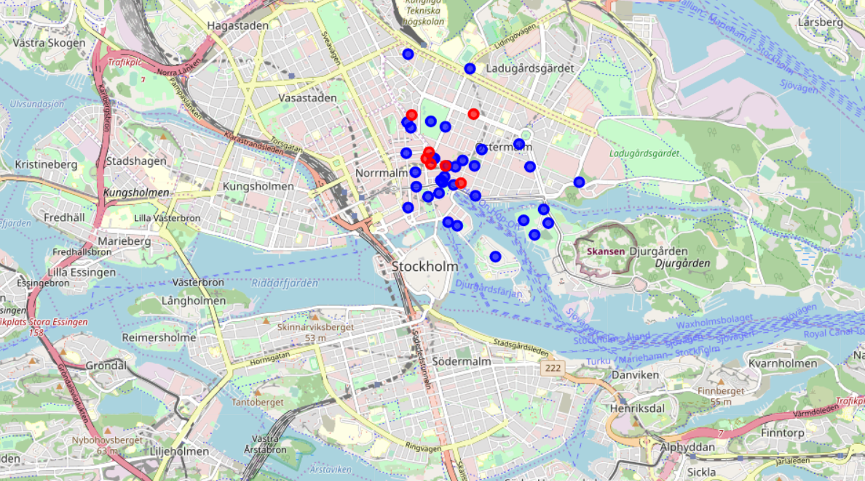
Results
The following map shows the competitive locations in red and the attractions in blue for Ostermalm

Slide 11
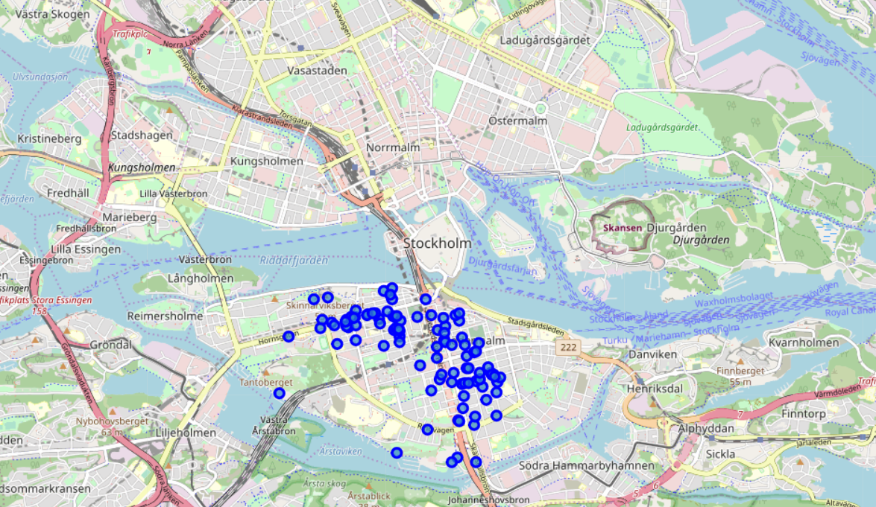
Results
The below map shows the venues in Sodermalm

Slide 12
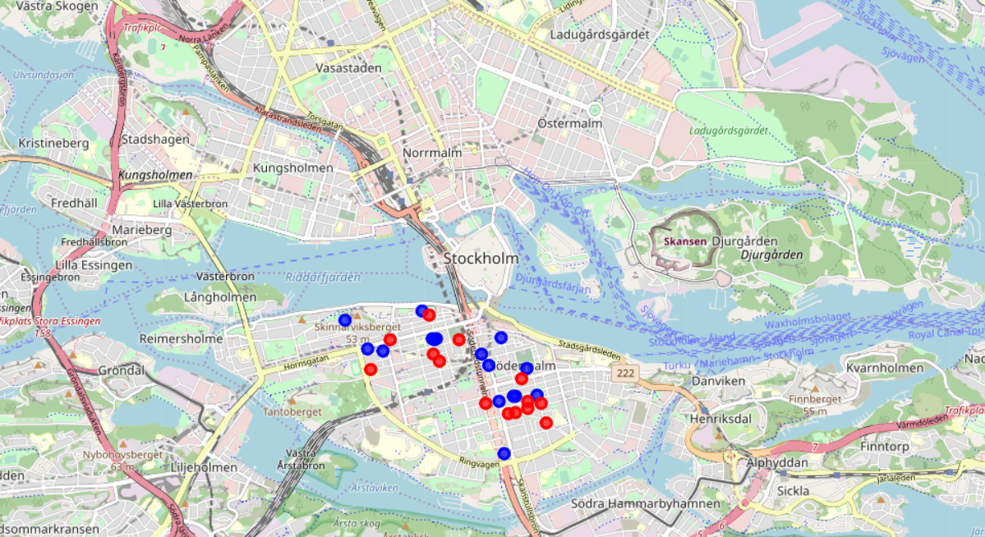
Results
The following map shows the competitive locations in red and the attractions in blue for Sodermalm

Slide 13
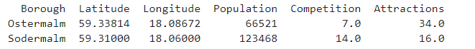
Results
The below table summarizes the count of competition and attractions.
Ostermalm has both the higher attraction count and lower competition count

Slide 14
Discussion
There are a few potential issues that seem to crop up in the data, that may require further investigation
The count of the relevant venues seems to be too small for a major European city, suggesting some venues may not be included or properly categorized
There may be further need to differentiate the attractions and give them different weightings. A museum may attract more visitors and potential customers than a shoe store for instance.

Slide 15
Conclusion
The immediate conclusion would be that Ostermalm is the better place to open a coffee shop. There is both less competition and more attractions to pull in potential customers

